Slide 1

Tech Titans
Tioluwani Adesina, Luca Furino, Alessandro Pomponi, Michel Al Khouri

Slide 2
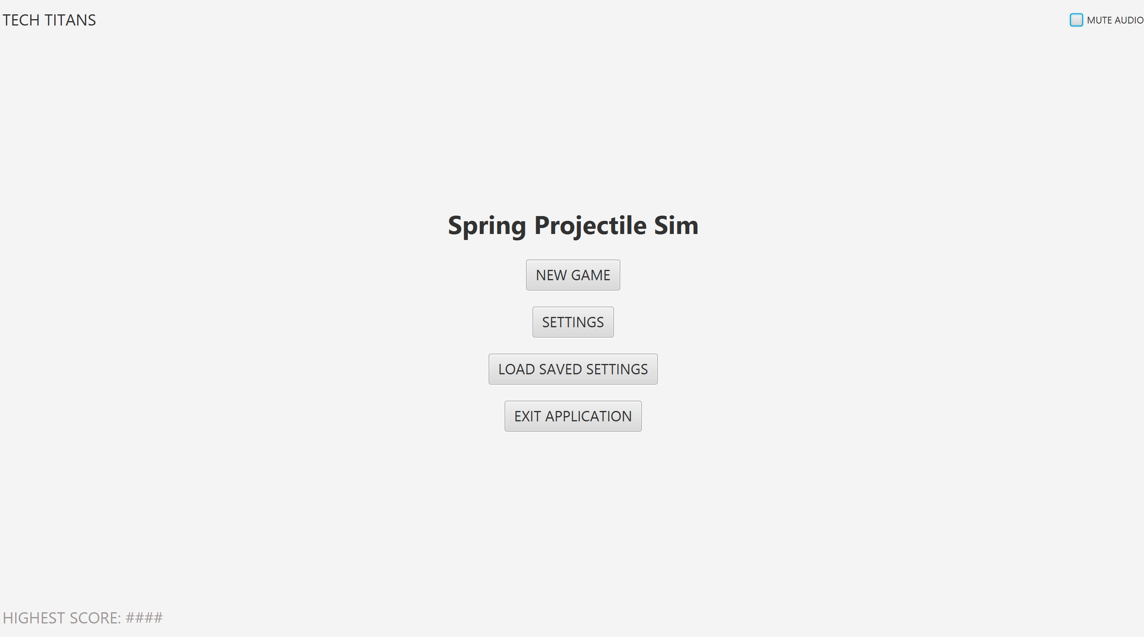
Starting Menu Scene

Slide 3
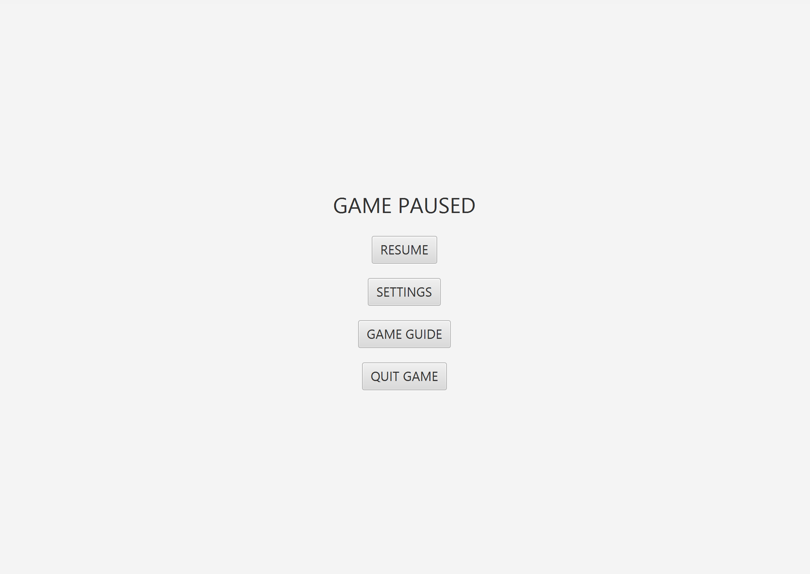
Game Paused

Slide 4
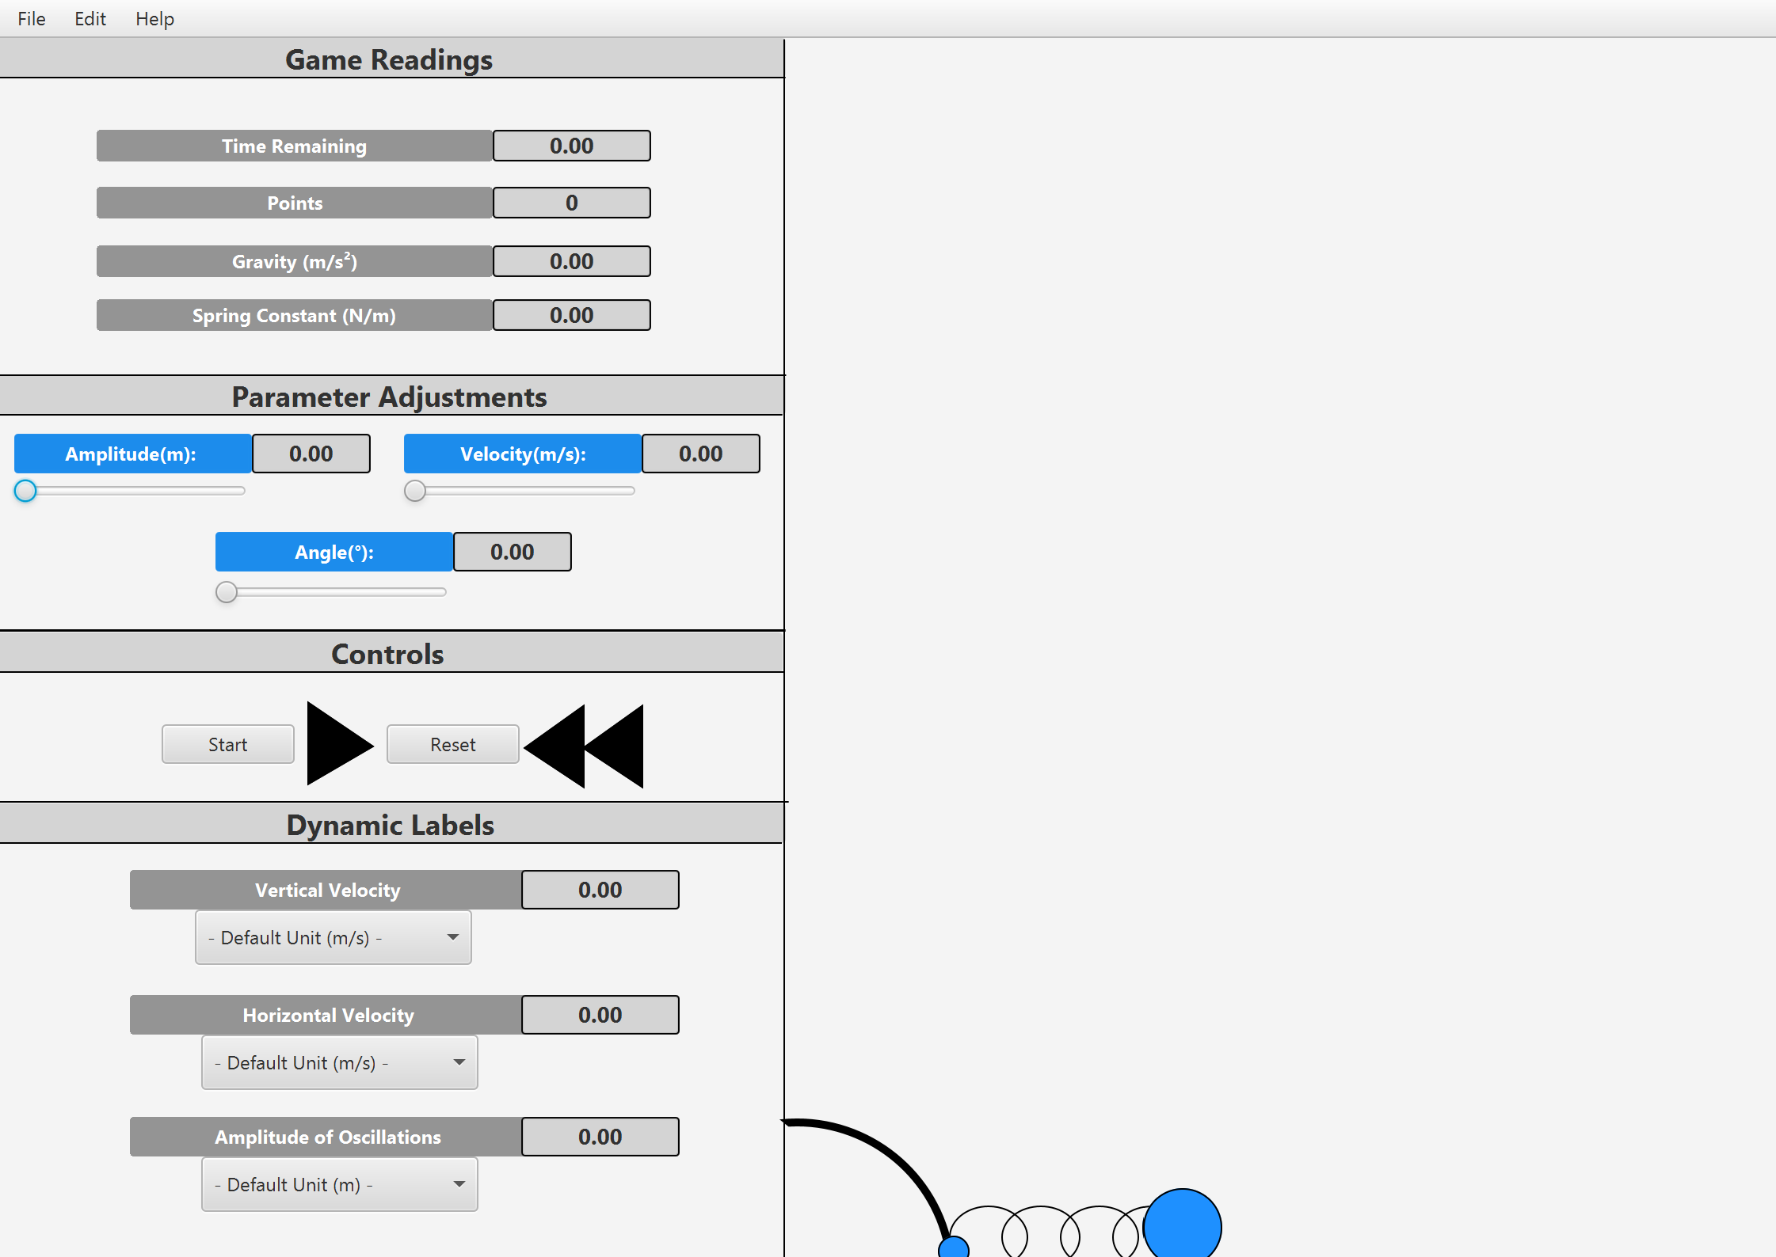
Physics Game Scene

Slide 5
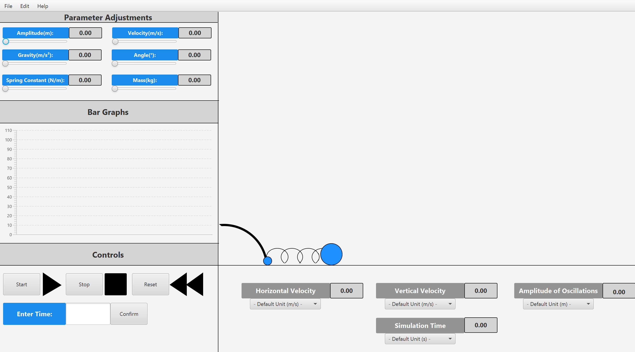
Physics Game Scene

Slide 6
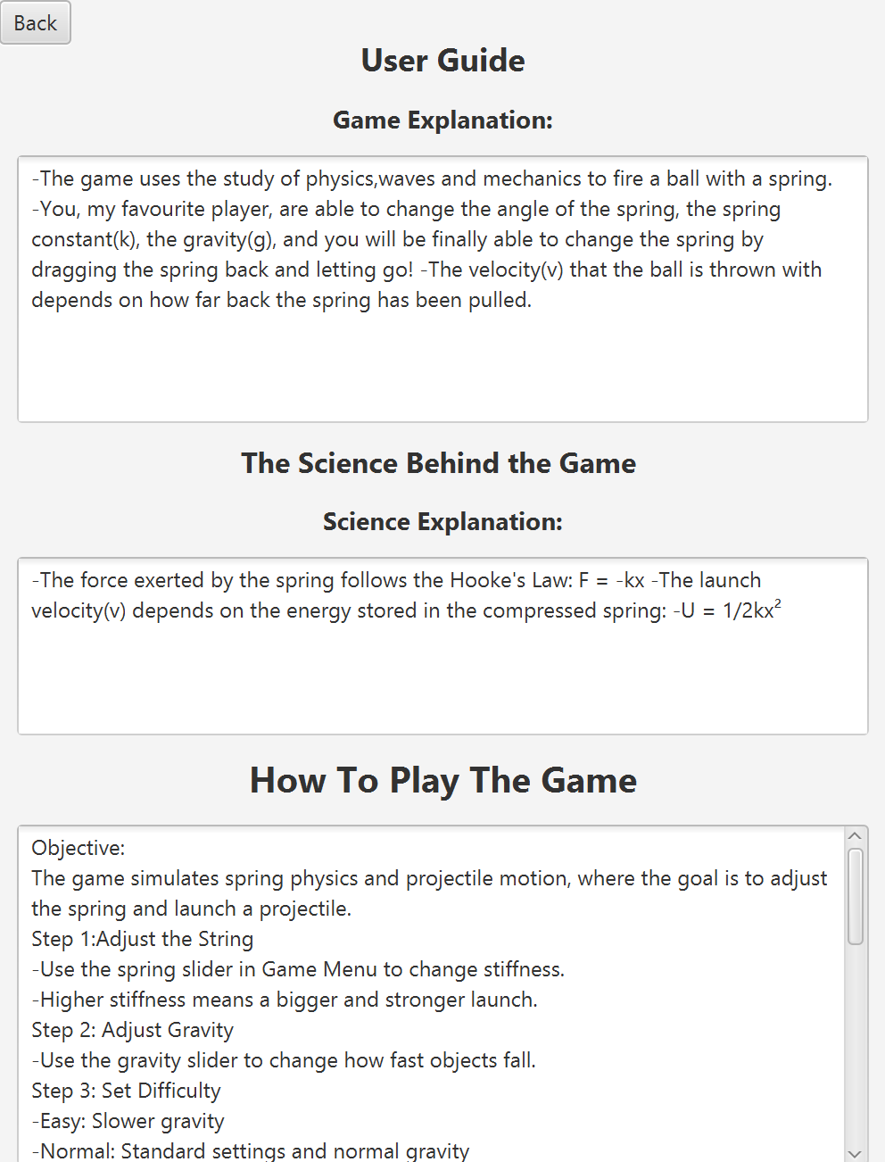
User Manual

Slide 7
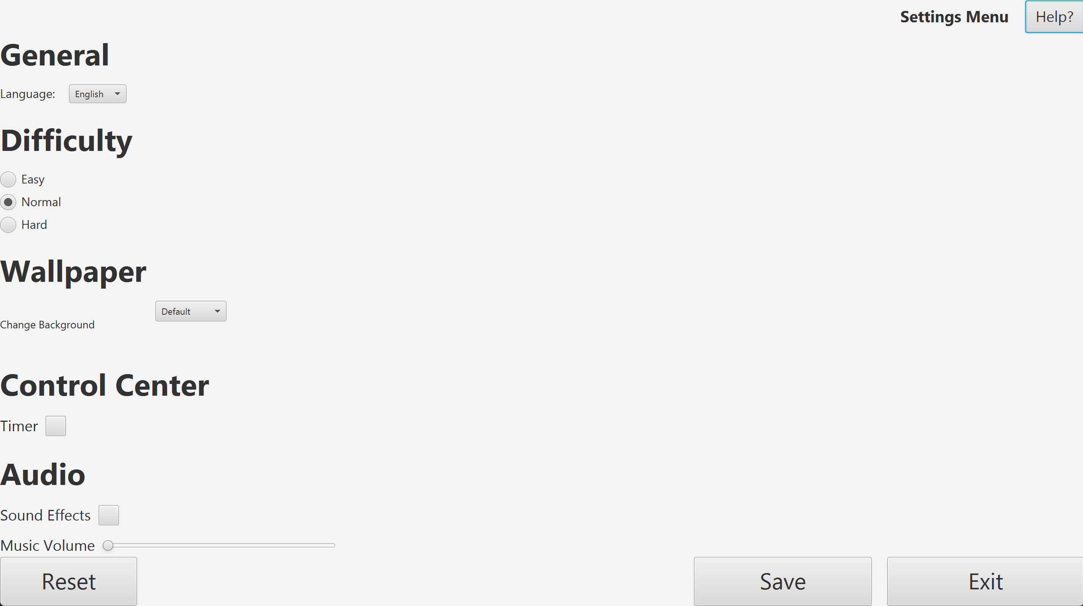
Settings Scene

